Slide 1

Database management system
By Lecturer
Olivier Kevin Angel ISHIMWE
Course Code & Name
1

Slide 2
Chapter 1 Objectives
Some common uses of database systems.
Characteristics of file-based systems.
Problems with file-based approach.
Meaning of the term database.
Meaning of the term Database Management System (DBMS).
Typical functions of a DBMS.
Major components of the DBMS environment.
Personnel involved in the DBMS environment.
History of the development of DBMSs.
Advantages and disadvantages of DBMSs.

Slide 3
Data: Raw, unprocessed facts
Ex:25, Kigali, Alphonse
Information: processed data
Ex: the age of alphonse is 25.
A database: a collection of related data,
Ex: online banking system, library management system.

Slide 4
Meta-data the database definition
The database management system (DBMS) is the software that interacts with end users, applications, and the database itself to capture and analyze the data. The DBMS software additionally encompasses the core facilities provided to administer the database. The sum total of the database, the DBMS and the associated applications can be referred to as a "database system".

Slide 5
Course Introduction
Database Languages – a combination of Data Definition Language (DDL) and Data Manipulation Language (DML).
DDL – used for constructing database structures or objects that will accommodate data.
DML – used for retrieving and modifying data in the database structures.
DCL - Data Control Language
TCL - Transaction Control Language
SQL is standard Query language for communicating with a Relational Database. Examples of Relational Database Management Systems (RDBMS): Oracle, MySQL, Sybase, Informix, etc.

Slide 6
DBMS Languages
DDL - Data Definition Language
Create: if for creating tables or databases
Alter: alter the structure of the database
Drop: delete tables or database
Truncate: remove all the records from the table
2) DML - Data Manipulation Language
Select: retrieve the data from the database.
Insert: insert data to the database
Delete: to delete a single/multiple/all records based of conditions
Update : update the data in database

Slide 7
3)DCL - Data Control Language
Grant: giving privileges to the user to access the database
Revoke: taking back the permissions given to the user
4)TCL - Transaction Control Language
Commit: save the transaction to the database.
Rollback: undo the recent transaction

Slide 8
Motivation
Many people need to store data of various kinds for a variety of reasons.
A database (DB) is a major component of an Information System.
What is an Information System (IS)?
A computer-based IS includes a DB, DB software, application software, computer hardware and personnel using and developing the system.

Slide 9
Examples of Database Applications
Purchases from the supermarket;
A bar code reader scans each purchase.
An application program then uses the barcode to find the price of the item from the product database.
Program reduces number of items in stock and displays the price on the cash register.
Purchases using your credit card;
There is need to check if there is enough credit on a card either by telephone or card reader linked to a computer.
A database keeps track of all the purchases you make using the card.
Before a transaction is made a program checks if the card is not stolen or lost or forged and balance and purchase amount are compared.

Slide 10
More Exs of Database Applications
Booking a holiday at the travel agents;
A database contains holiday and flight details
The database system will ensure that 2 agents do not book the same holiday or over book the seats on flight
Using the local library;
Database with details of books in the library
An application can allow the user to find the book by title, author, subject area.
System can allow reservations to be made and reminders sent to library users on when books are available or due.
Taking out insurance;
Need to access a database containing figures of various insurance companies

Slide 11
Contd Exs of Database Applications
Your personal details are used by the database system to determine the cost of insurance.
Using the Internet;
Online shopping. e,.g Amazon.com keeps track of all purchases.
Studying at university;
Database containing several details on students and staff.
Many database applications for different purposes.

Slide 12
File-Based Systems
Collection of application programs that perform services for the end users (e.g. production of reports).
Each program defines and manages its own data.
It replaced manual system of logically arranging documents, labelling files and use of well locked cabinets.

Slide 13
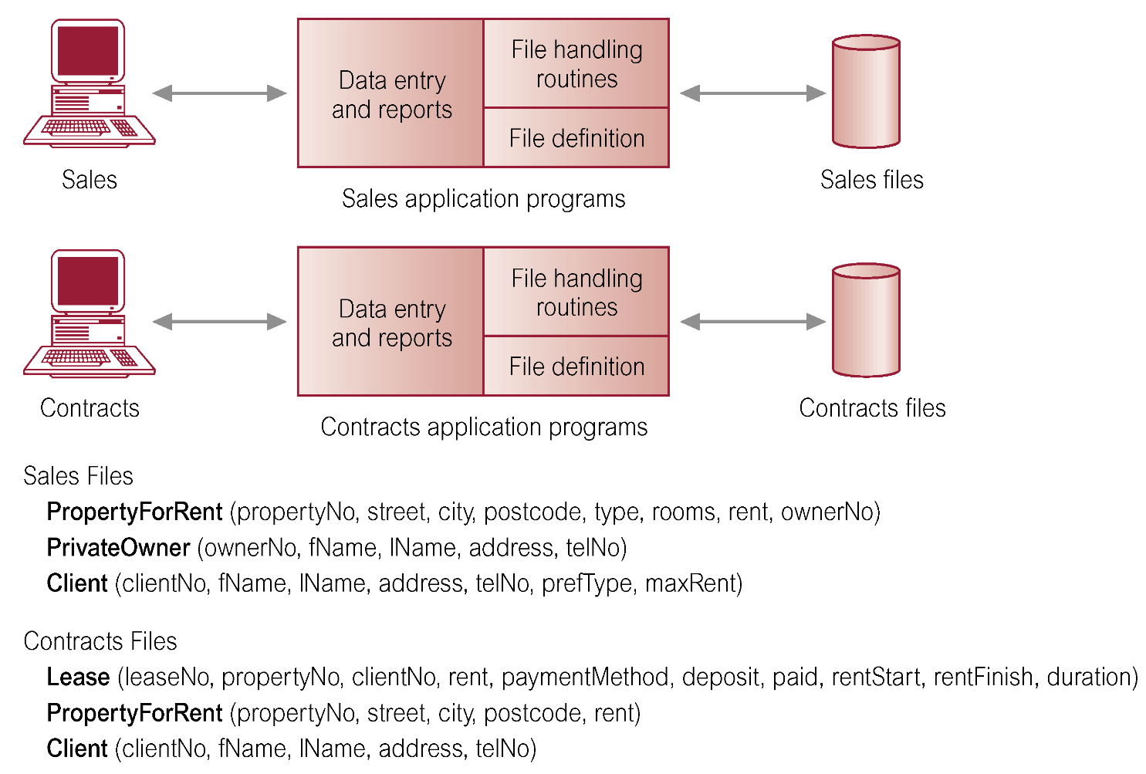
File-based Processing

Slide 14
Limitations of File-Based Approach
Separation and isolation of data
Each program maintains its own set of data.
Users of one program may be unaware of potentially useful data held by other programs.
Duplication of data
Same data is held by different programs.
Wasted space and potentially different values and/or different formats for the same item.
Data dependence
File structure is defined in the program code thus program- data dependence.

Slide 15
Contd Limitations of File-based Approach
Incompatible file formats
Programs are written in different languages, and so cannot easily access each others files.
Fixed Queries/Proliferation of application programs
Programs are written to satisfy particular functions. Any new requirement needs a new program.

Slide 16
Database Approach
Arose because:
Definition of data was embedded in application programs, rather than being stored separately and independently.
No control over access and manipulation of data beyond that imposed by application programs.
Result
the Database and Database Management System (DBMS).

Slide 17
Database
A Shared collection of logically related data (and a description of this data), designed to meet the information needs of an organization.
System Catalog or Data Dictionary (metadata)
Data about data.
provides description of data to enable program–data independence.
Hence a database is a self describing collection of integrated records.
Logically related data comprises entities, attributes, and relationships of an organization's information.

Slide 18
Database Management System (DBMS)
A software system that enables users to define, create, and maintain the database and which provides controlled access to this database.

Slide 19
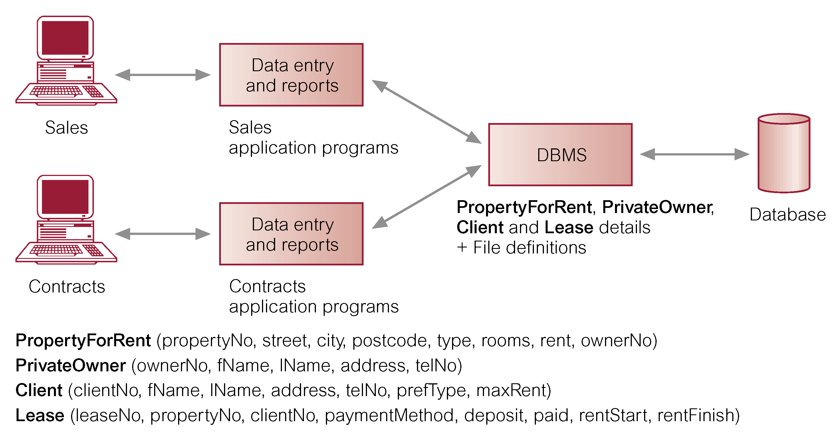
Database Management System (DBMS)

Slide 20
Database Approach
Data definition language (DDL).
Permits specification of data types, structures and any data constraints.
All specifications are stored in the database.
Data manipulation language (DML).
General enquiry facility (query language) of the data.

Slide 21
Database Approach
Controlled access to database may include:
A security system.
An integrity system.
A concurrency control system.
A recovery control system.
A user-accessible Catalog (metadata).
A view mechanism.
Provides users with only the data they want or need to use.

Slide 22
Views
Allows each user to have his or her own view of the database.
A view is essentially some subset of the database.
End users are not interested in how complex or easy a task is for the system.
For users not to view data that they don’t need, a view mechanism is needed Allows each user to have his or her own view of the database.

Slide 23
Benefits of Views Include;
Reduce complexity;
Provide a level of security;
Provide a mechanism to customize the appearance of the database (different users may wish to call a variable in a way they understand it best);
Present a consistent, unchanging picture of the structure of the database, even if the underlying database is changed. E.g addition and removal of fields etc

Slide 24
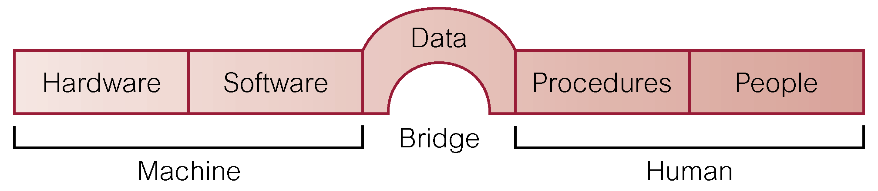
Components of DBMS Environment

Slide 25
Components of DBMS Environment
Hardware
Can range from a PC to a network of computers.
Software
DBMS, operating system, network software (if necessary) and also the application programs.
Data
Used by the organization and a description of this data called the schema.
Procedures
Instructions and rules that should be applied to the design and use of the database and DBMS.
People

Slide 26
Database Design: Paradigm Shift
The change in approach of satisfying and organization's information needs.
In file based systems, work was driven by the application needs of individual departments.
But to satisfy organization information needs, database approach is needed where a company has to think of the data first and the application second.
A poorly designed database can cause several errors and lead to poor or wrong decisions.

Slide 27
Roles in the Database Environment
Data Administrator (DA)
Manages data resources like database planning, development and maintenance of standards, policies and procedures, conceptual or logical database design.
Consults managers & ensures that the direction of database development will support cooperate objectives
Database Administrator (DBA)
Responsible for physical realization of the database, i.e;
Physical database design and implementation
Security and Integrity control
Maintenance of the operational system
Ensuring satisfactory performance of applications for users

Slide 28
Database Designers (Logical and Physical)
In large database projects, it is vital to have a Logical database designer and a physical database designer.
Logical database designer; concerned with identifying the data (entities and attributes), the relationships between the data, and the constraints on the data that is to be stored in the database.
Must understand organisation’s data and business rules
For effectiveness, should closely work with database users
Work is divided into Conceptual database design and logical database design.

Slide 29
Conceptual Database design; is independent of implementation details like type of DBMS, application programs, programming languages, etc.
Logical database Design; targets a specific data model e.g. Relational, Network, Hierarchical.
Physical database designer; decides how the logical database is to be realized.
Involves mapping the logical database into a set of tables and integrity constraints
Select specific storage structures and access methods for the data
Designing security measures

Slide 30
Note: Conceptual and Logical database design are concerned with WHAT, where as physical database design is concerned with HOW
Application Programmers; design programs that request the DBMS to perform some operations on the database. E.g retrieve data, inserting, updating, and deleting data.
End Users (naive and sophisticated)
Naïve; unaware of DBMS and access the database through application programs
Sophisticated; familiar with the structure and facilities of the database and can use SQL to perform required operations, or even develop application programs

Slide 31
Advantages of DBMS
Control of data redundancy; integrating files and avoiding multiple copies of the same data.
Redundancy is not eliminated completely because of performance reasons.
Data consistency; controlling redundant data reduces on risk of inconsistent data.
More information from the same amount of data ; data integration will help derive more meaning/relationships from data.
Sharing of data; improves efficiency.
Improved data integrity; validity and consistence of the stored data. Achieved by use of constraints on the data

Slide 32
Improved security; protection of the database from unauthorised users.
This is vital because all company data has been integrated and that’s risky without security.
Enforcement of standards; integration allows the DBA to enforce standards like departmental, organisational, national, international for data. E.g data formats, data exchange, documentation standards, update procedures etc.
Economy of scale; cost saving instead of spending money on each department for all the different file based systems the department will need over time.

Slide 33
Balanced conflicting requirements; different departments have varying needs but a DBA decides on the design and operational use of the database for the best of the organisation.
Improved data accessibility and responsiveness; data crosses departments and ad hoc(unplanned) questions can be asked unlike fixed queries in file based systems
Increased productivity; programmers dwells on functionality not low level details of data.

Slide 34
Improved maintenance through data independence; data description is separate from the application. Applns are immune to changes in data descriptions.
Increased concurrency; two or more users can access data at the same time without loss of data integrity.
Improved backup and recovery services; DBMS provides facilities of minimizing amount of processing that is lost following a failure.

Slide 35
Disadvantages of DBMS
Complexity; serious and careful planning is required to get a good DBMS, otherwise there might be serious consequences
Size; large size of software taking large disk space and memory.
Cost of DBMS
Additional hardware costs; e.g storage, memory etc
Cost of conversion; costs of converting existing applications to run on the new DBMS and hardware, employing specialists, training staff etc.
Performance; some applications may not run as first as the used to because DBMS caters for several applications at once.
Higher impact of a failure; integration of resources increases vulnerability.

Slide 36
DB Terminologies
A database is an organized collection of related data.
A DBMS is software that facilitates the creation and maintenance of the database; it supports database languages (DDL and DML) and has features such as security, transaction management, backup, and recovery.
A database system is a DBMS together with the data itself.
A database application is a program that interacts with a database at some point in its execution.
A relational database management system (RDBMS) a software package which stores and manages data in a relational DB.
A relational DB is a collection of tabular structures that can be related to each other by a common field.

Slide 37
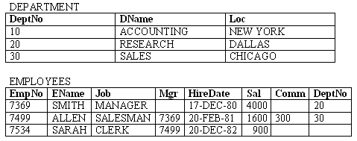
Example of a Relational DB
A company needs to store information on departments and employees.
Each table contains data that describes exactly one entity - a thing of significance about which information needs to be known.

Slide 38
Relational Database Concepts
Relation – a table composed of rows and columns
Attribute/field – a column of a relation.
Tuple/record – a row of a relation.
Cell – an intersection of a row and a column of a relation.
Domain – a set of allowable values for one or more attributes.
Null – a value that is unknown or not applicable in a given cell.

Slide 39
Relational Database Concepts Cont’d
Degree – number of attributes/fields for a given relation.
Cardinality – number of tuples/records for a given relation.
Relation schema – a named collection of attributes and any data constraints.
Representation of a department relation schema
DEPARTMENT (DeptNo, DName, Loc)
EMPLOYEES(EMPNO, ENAME, JOB, MGR, HIREDATE, SAL, DEPTNO)
Data Constraints:
A department name value must never be repeated.

Slide 40
Relational Database Concepts Cont’d
Relational database – a finite set of relational schemas.
Representation of a relational database schema for a company that stores information on departments and employees.
DEPARTMENT (DeptNo, DName, Loc)
EMPLOYEES (EmpNo, EName, Job, Mgr, HireDate, Sal, Comm, DeptNo)
Data Constraints:
A department name value must never be repeated.
No employee should earn a salary that is more than 5000.

Slide 41
Relational Database Concepts Cont’d
Primary key – This is a field in a table which is used to uniquely identify a record in a table.
A record is a row in a table
If a field is identified as a primary key, no two rows can have the same values .
Unique key – attribute(s) that contains distinct values but can also accommodate null values.
Foreign key – A foreign key is a primary key in another table.
In this table where is a foreign key no values may be inserted in that column unless if exists in the other table where it’s a primary key

Slide 42
Properties of Relations:
Uniqueness of relation names in a relational database schema.
Uniqueness of attributes for a given relation
Uniqueness of tuples for a given relation
Order of attributes / tuples for a given relation is not significant
Values of an attribute are from the same domain.
A cell of a relation contains exactly one atomic (single) value.

Slide 43
Thank you

